Slide 1
AED Final project : National Vaccine Distribution System
Made By:
Vaibhav R Mistry
NUID: 001722678

Slide 2
The problem:
Current Supply and Demand of Vaccines
CDC not aware about the flow of vaccines in the state
Storage and Distribution of Vaccines costly and complicated
Maintaining the Cold – Chain
Incomplete Reports of VARES
Post- Administered Vaccine side/ill-effects.
Lacks a homogeneous sys

Slide 3
The Solution:
Information Technology is a powerful tool that could help in alleviating the sufferings.
The tool to reduce the issues mentioned is an information system that provides a homogeneous approach to the vaccine distribution system.
Using the application engineering technology, efficiency, accountability and safety could be improved whereas public health crises could be reduced.

Slide 4

The Solution:
vDistribute

Slide 5
KEY FEATURES:
A single homogeneous system for all the vaccine players
Maintaining the supply and demand of vaccines throughout the system.
a) Depending on the demand of the vaccines, CDC ordering vaccines from the Manufacturers and storing the vaccines in the warehouses of National Distributor.
b) Providers creating the orders on contract basis(bi-monthly or monthly) or ad-hoc requests depending on their anticipated demand forecast.
c) Even Satellite clinics associated with the providers can create orders for their activities.
d) Provider orders and satellite clinic orders (after approval of the provider) going through series of approvals from Public Health Department (State Level) and from PHD to CDC (Federal Level).
e) Vaccine orders approved/rejected based on the population of state.
f) Distributor shipping the vaccines to the respective sites based on the vaccines in the inventory.
g) Vaccines being stored in the inventory at the respective sites.

Slide 6
KEY FEATURES
Administering vaccines and keeping a track of the records of the vaccines administered to the patients at both provider and at the satellite clinic levels.
Providing an overview of the vaccines distributed to a granular level ie. state-wise, city-wise and provider-wise.
Maintaining the cold-chain of the vaccines inventoried at Distributor warehouse and at Provider.
User Profile for all the users in the system could be updated at ease without intervention from administrator.
Satellite Clinics can register new patients without the administrator's intervention for their activities.

Slide 7
KEY FEATURES
Vaccine Adverse Event Reporting System:
a) Providing complete reports to VARES for the failed vaccines state-wise, city-wise, provider-wise and to the minute details such as the side effects reported for the failure by the patient!
b) CDC can send a "Recall" to the manufactures and the Distribution if it thinks that a particular batch of vaccines are failing so that the "failed" vaccine batch is removed from the system and no further orders could be placed on the that particular batch of vaccines.
Patients can login and report side effects or ill-effects of vaccines after the vaccine is administered to them.

Slide 8
KEY FEATURES
Complete Financial Model being captured for all the Players
a) Manufactures receiving payments on orders from CDC.
b) Vaccine funding from Federal or State.
c) Distributor receiving payments from CDC, PHD or Provider based on the funding of vaccines.
d) Patient's insurance model is captured and based on the insurance, patient or the insurance company being charged for the vaccine if not funded.
e) Keeping track of the past and the pending payments for all major vaccine players.

Slide 9
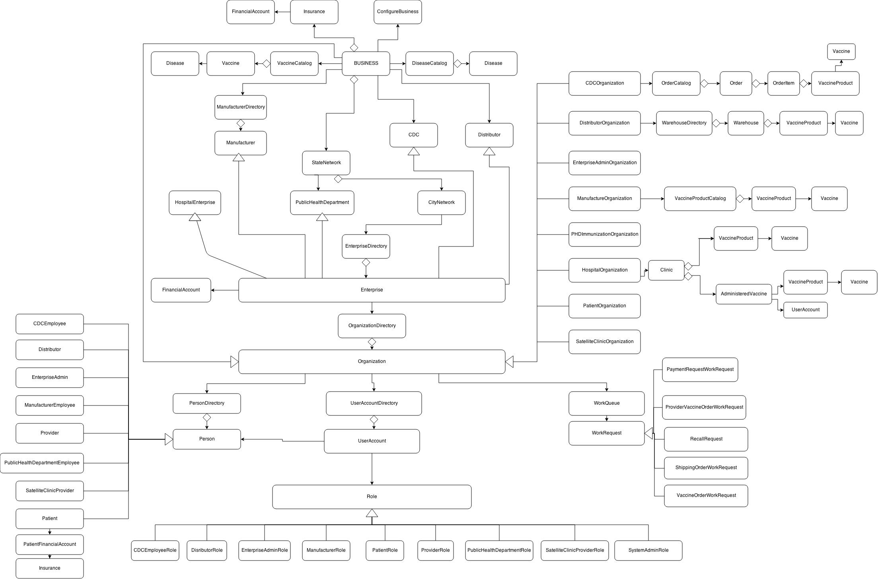
Object model:

Slide 10
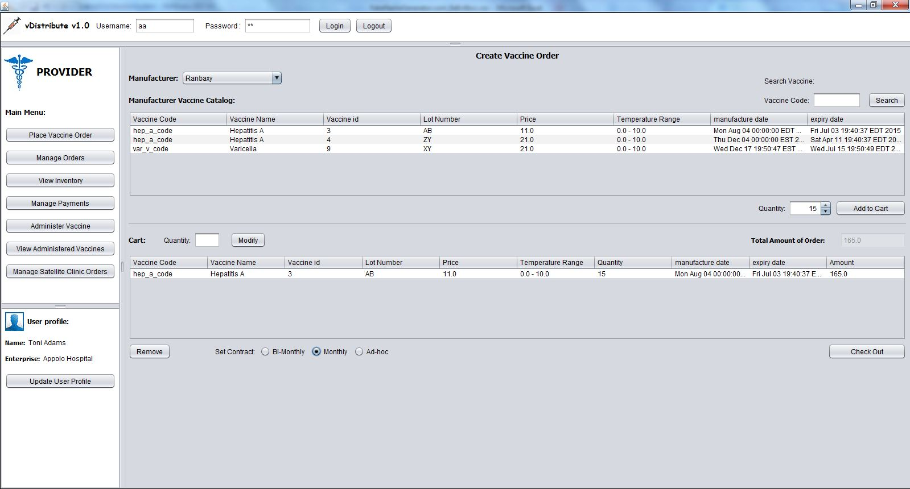
Screenshots: Creating Order

Slide 11
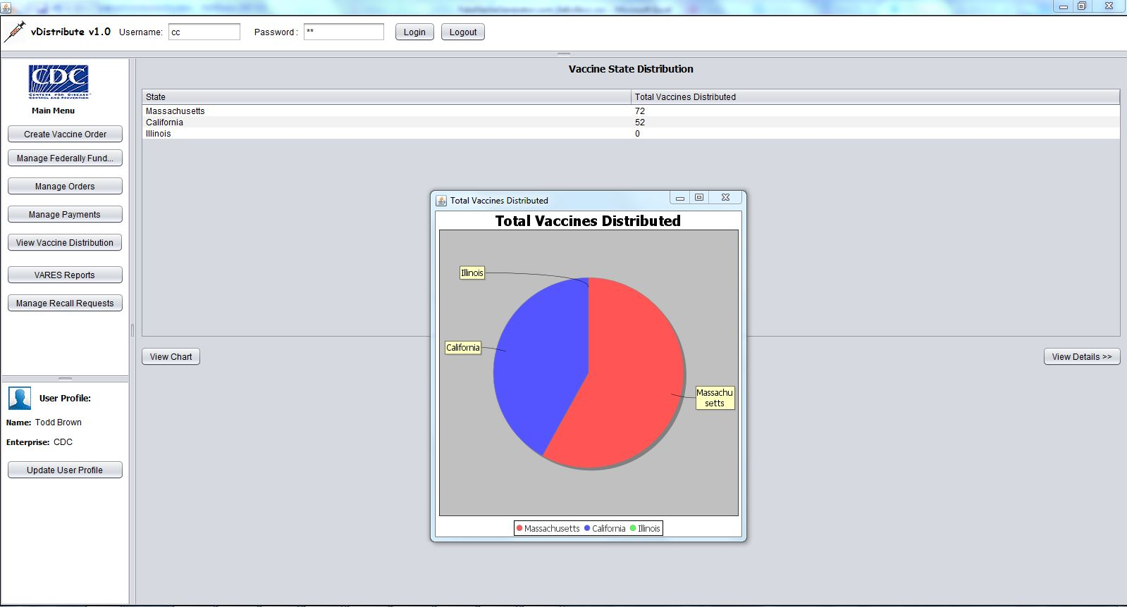
Screenshots: vaccine distribution overview

Slide 12
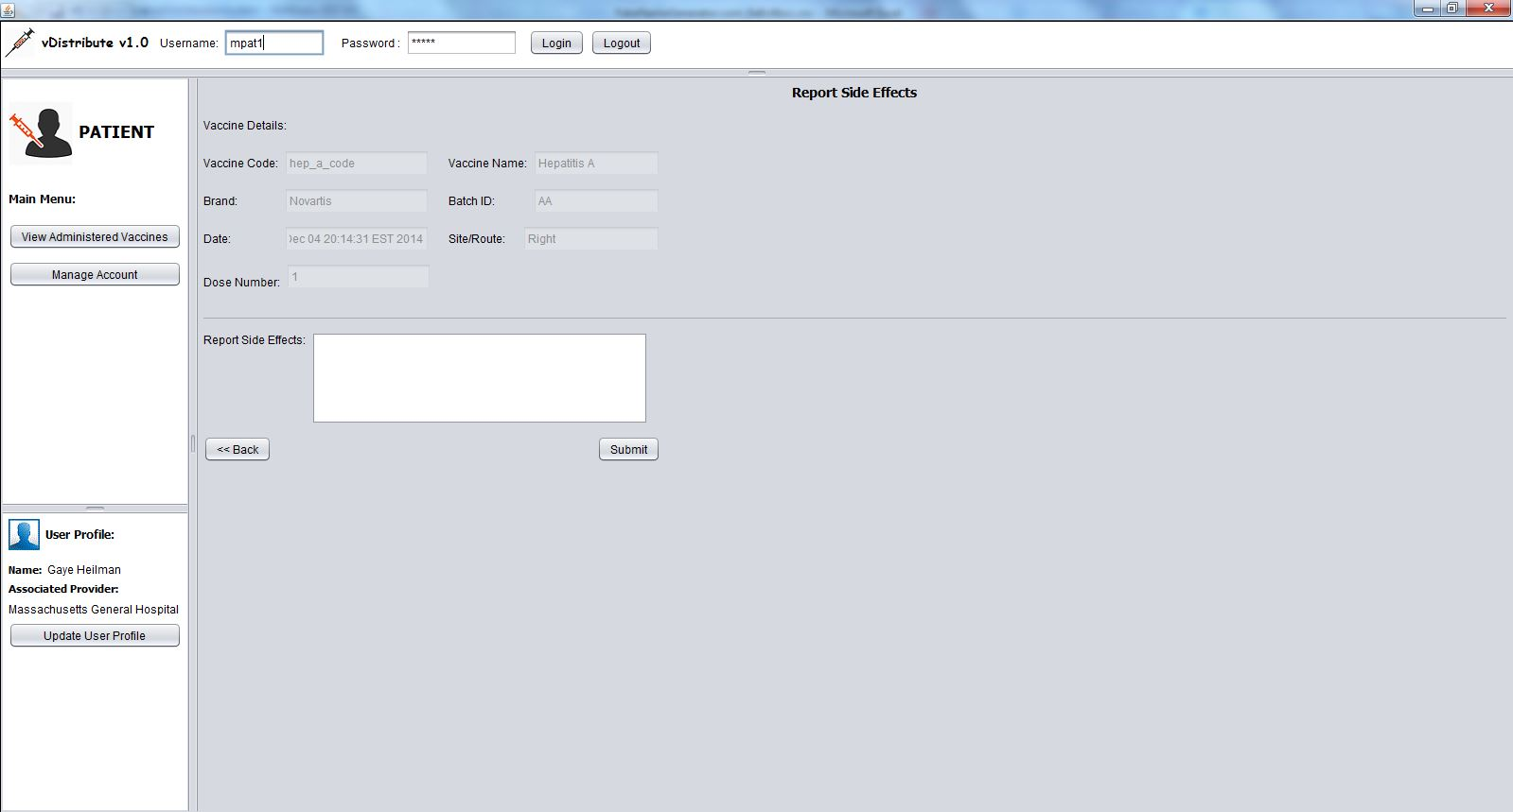
Screenshots: patient logging side effects

Slide 13
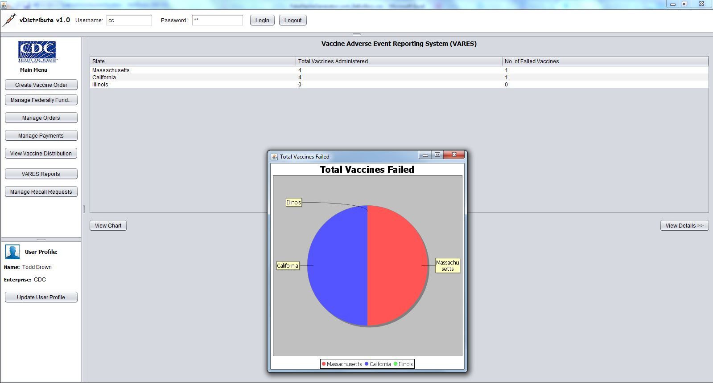
Screenshots: vares reports of failed vaccines

Slide 14
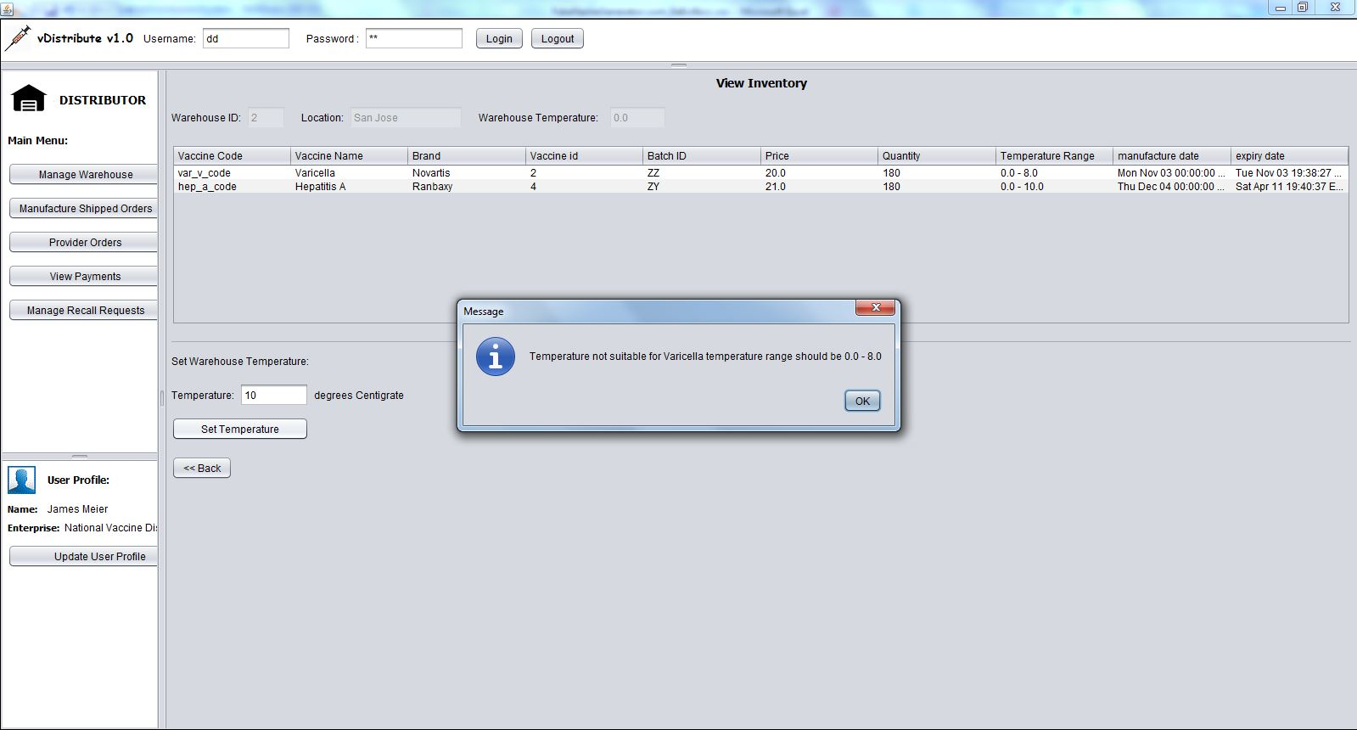
Screenshots: maintaining vaccine cold chain

